Slide 1

NC Census Employment Data analysis
EJ, Bill, Abby, Teshanee, Niral

Slide 2
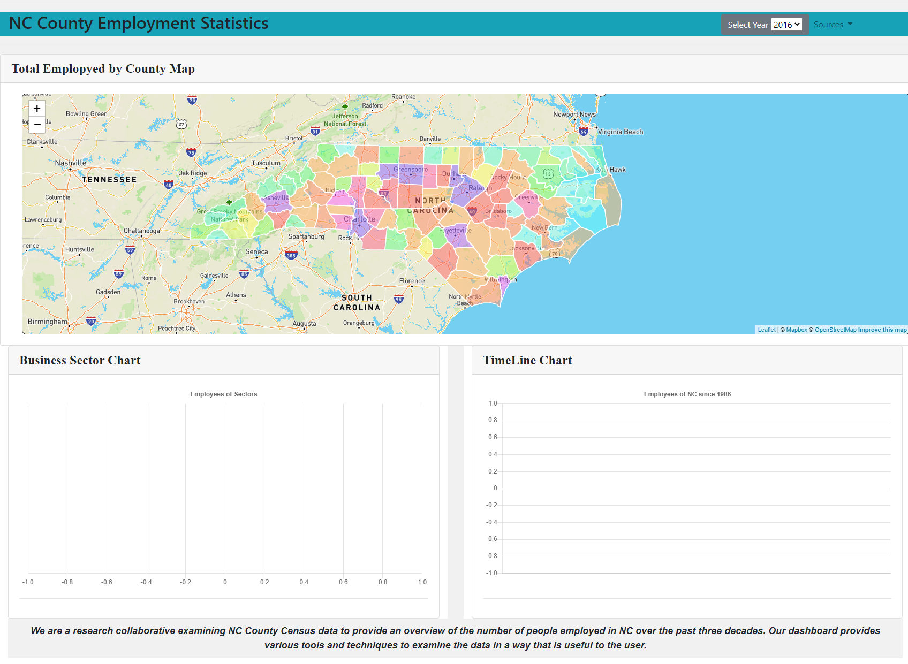
Product Introduction
Show the working site
Explain all features on the site
Data visualization information

Slide 3
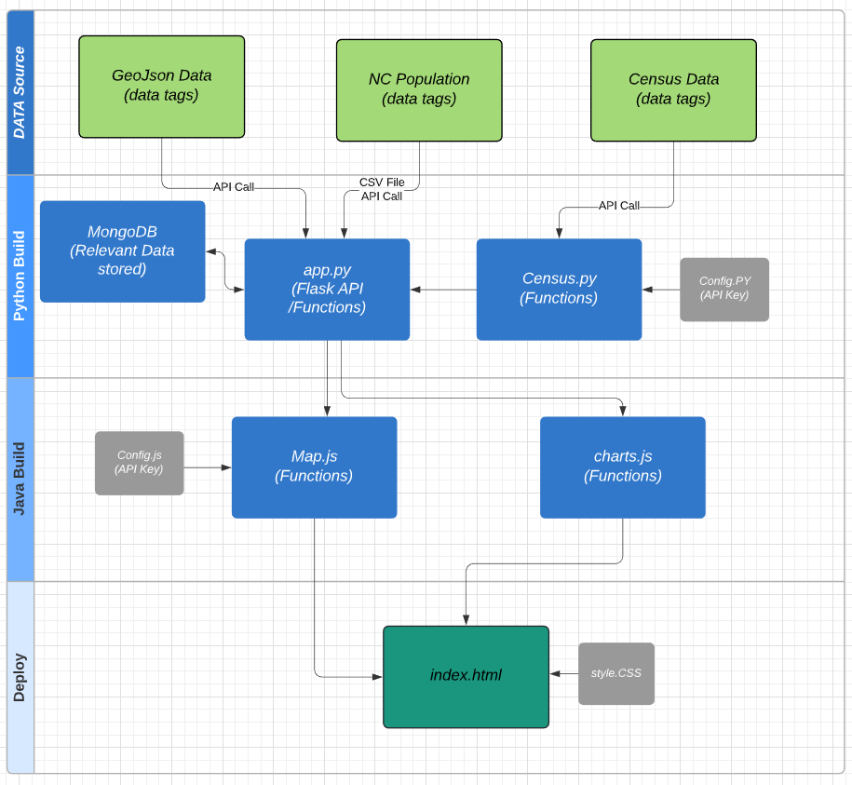
High Level Data Flow
List of
Leaflet
Flasks
MongoDB
Chart.js
Mapbox
D3
Json
bootstarp
Notes:
Three main phase
Data sources
Build (Python, Java & HTML)
Deploy

Slide 4
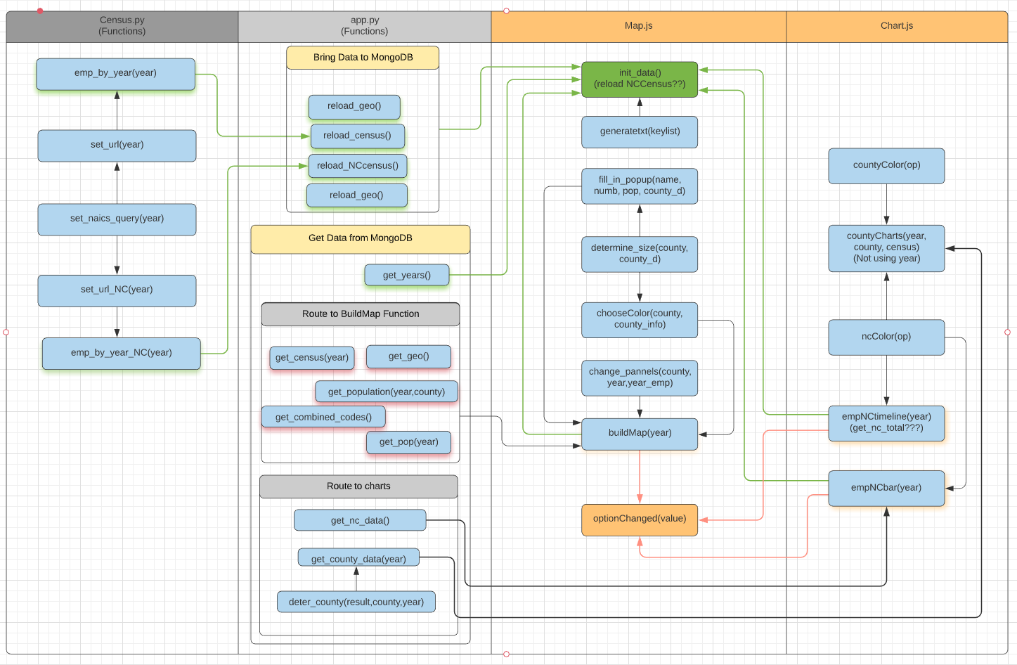
Function Flow Diagram

Slide 5
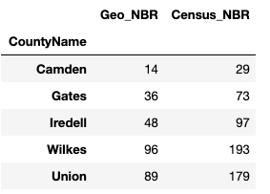
Data Collection
MongoDB: censusdb
Collection: census
1986 | 1988 | 1990 | 1992 | 1994 | 1996 | 1998 | 2000 | 2002 | 2004 | 2006 | 2008 | 2010 | 2012 | 2013 | 2014 | 2015 | 2016 | 2017 | 2018
CBP: Total EMP
Query variables for API call:
GEO_TTL, EMP
CBP: Total EMP
NAICS1997_TTL,
GEO_TTL,
EMP
CBP: Total EMP
NAICS2002_TTL,
GEO_TTL,EMP
CBP: Total EMP
NAICS2007_TTL,
GEO_TTL,
EMP
County Business Patterns(CBP):
Business Sectors EMP
GEO_TTL,
EMP
CBP: Business Sectors EMP
NAME,
EMP
MongoDB: censusdb
Collection: nccensus
County Codes(Number) – json file
CBP: State-wide EMP
CBP: State-wide EMP
CBP: State-wide EMP
CBP: State-wide EMP
CBP:
State-wide Business Sectors EMP
CBP: State-wide Business Sectors EMP
CSV file
Population: 1980, 1990, 2000 census results
Source: NC census demographic data
Population: 2001~ 2009
Source: Population Estimate Program of Census.gov
Population: Annual County Population
Source: NC OSBM demographic table

Slide 6
Summary
Notes:
Purpose of building this page
Speak to the dashboard in the summary
Explain some of the observation over various year data

Slide 7
Question?

Slide 8
APP Routes
Loading data to MongoDB (Initialize)
/reload_geo
/reload_census
/reload_nccensus
Get Map, County codes data
/get_geo", methods=["GET"])
/get_combined_codes
Get EMP data
/get_census/<year>"
/get_county_data/<county>
/get_nc_data/<year>
/get_nc_total/<year>
Get Population data
/get_population/<year>/<county>
/get_pop/<year>

